Slide 1
Prototype Creational Patterns
<Tomás Laranjo> - <107542>
April 24th, 2024

Slide 2
When should we use this pattern?
It should be used in:
Complex Object creation
Efficient creation of objects with complex initialization processes.
Saves resources by cloning existing instances instead of creating from scratch.
Dynamic Object creation
Creates new instances dynamically during runtime or based on user input.
Clones existing prototypes and adjusts properties as needed.
Avoiding Subclassing
Generates object variations without subclassing.
Clones prototypes and modifies properties to create new objects.
Stateful Objects
Shares initial state among multiple instances.
Clones prototypes and customizes state for each instance.
Performance Optimization
Improves performance by reducing overhead in object instantiation.
Especially useful in scenarios where object creation is a bottleneck.

Slide 3
How to implement this pattern?
To implement the Prototype pattern, there is 3 simples steps that should be done:
Define Prototype Interface or Base Class
Implement Concrete Prototypes:
Develop Concrete classes that implement the prototype interface or extend the base class
Implement the cloning method within these classes to generate copies of objects
Instantiate Protypes and Clone:
Create instances of prototypes and initialize them with desired properties
Utilize the clone method to generate new objects based on existing prototypes when required

Slide 4
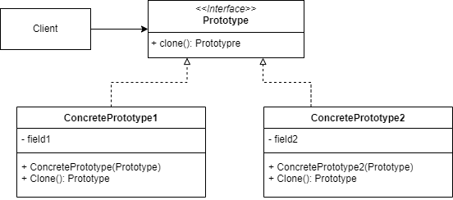
(Base) Class Structure

Slide 5
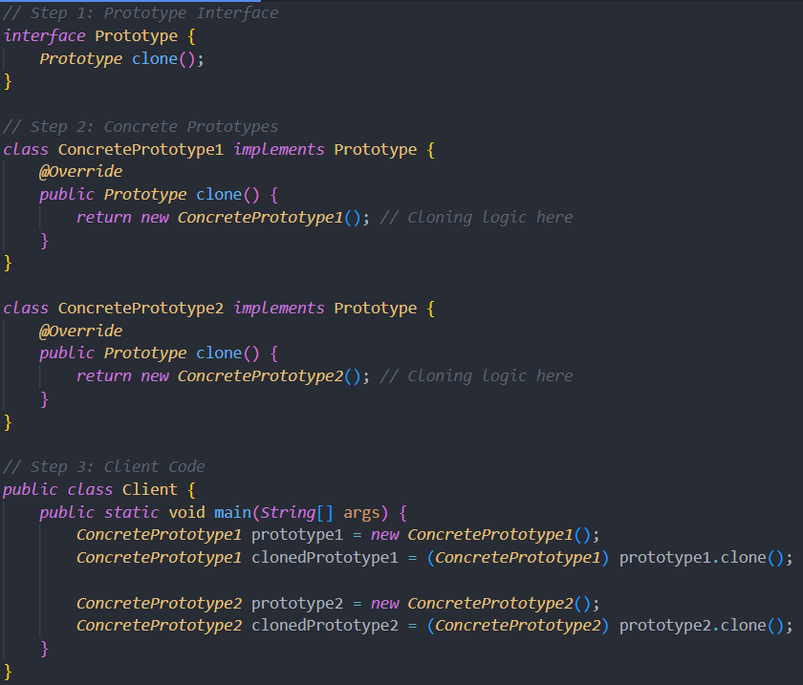
Code Example(s)

